Slide 1
Lecture 3
Topics
  IEEE 754 Floating Point
  Binary Codes
    BCD
    ASCII, Unicode
    Gray Code
    7-Segment Code
    M-out-of-n codes
  Serial line codes

Slide 2
Floating Point

Slide 3
Floating Point
Need to represent “real” numbers
Fixed point too restrictive for precision and range
Not unlike familiar “scientific notation”
+ 6.022 x 10²³
Sign
Mantissa
Exponent
Normalized mantissa – single digit to left of decimal point

Slide 4
IEEE 754 Floating Point Standard
Sign
Binary
Exponent
Significand
+ 1.101011 x 2¹²
Sign
Mantissa
Exponent
1
Fraction
A normalized (binary) mantissa will always have a leading 1
so we can assume it and get an extra bit of precision instead
Exponents are stored with a bias which is added to the exponent before being stored (allows fast magnitude compare)
Universally used on virtually all computers
Several levels of precision/range: Single, Double, Double-Extended

Slide 5
IEEE 754 Floating Point Standard
Single Precision – 32 bits, Bias = 127
1
8
23
±
Exponent + Bias
Significand
31
30
23
22
0
F = -1^{Sign} x (1+Significand) x 2^{(Exponent-Bias)}

Slide 6
IEEE 754 Floating Point Standard
Example
F = -1^{Sign} x (1+Significand) x 2^{(Exponent-Bias)}
1
8
23
1
10000001
01000000000000000000000
31
30
23
22
0
-
129
= 0.25₁₀
= - 1.01₂ x 2⁽¹²⁹⁻¹²⁷⁾
= - 1.25 x 2⁽¹²⁹⁻¹²⁷⁾
= - 1.25 x 2²
= - 1.25 x 4
= - 5.0
= - 1.01₂ x 2⁽¹²⁹⁻¹²⁷⁾
= - 1.01₂ x 2²
= - 101₂
= - 5.0

Slide 7
IEEE 754 Floating Point Standard
Will commonly see these expressed as hex
1
8
23
1
10000001
01000000000000000000000
31
30
23
22
0
8+2
8+4
C0A00000
1010 A
1011 B
1100 C

Slide 8
IEEE 754 Floating Point Standard
Some Special Cases
  Zero (no assumed leading 1)
    Exponent = 0, Significand = 0
  NaN (Not a Number), e.g. ∞
    Exponent = 255
  Denormalized (Subnormal) numbers
    Exponent = 0, Significand ≠ 0
F = -1^{Sign} x (1+Significand) x 2^{(Exponent-Bias)}
Bias = 127
Notes:
IEEE 754-2008 now calls them subnormal

Slide 9
IEEE 754 Floating Point Standard: subnormal numbers
Why do we need subnormal numbers?
    Addresses gap caused by implicit leading 1
    Smallest positive number (a) is 1.000…000 x 2⁻¹²⁶
    Next number (b) is 1.000…001 x 2⁻¹²⁶ = (2⁻¹²⁶ + 2⁻¹⁴⁹)
  Subnormal numbers
    Exponent = 0, Significand ≠ 0
Gaps!
b
-
+
S Exponent Significand
1 8 23
0
a
0 00000000 00000000000000000000000
0 00000000 00000000000000000000001
0 00000000 00000000000000000000010
0 00000000 00000000000000000000011
0 00000000 00000000000000000000100
= 0
= 1.00000000000000000000001 x 2⁻¹²⁷
= 1.00000000000000000000010 x 2⁻¹²⁷
= 1.00000000000000000000011 x 2⁻¹²⁷
= 1.00000000000000000000100 x 2⁻¹²⁷
Distance from zero to smallest positive number is 1.00000000000000000000001 x 2⁻¹²⁷ ~= 2⁻¹²⁷
Distance to next number is 0.00000000000000000000001 x 2⁻¹²⁷ = 2⁻²³ x 2⁻¹²⁷ = 2⁻¹⁵⁰

Slide 10
IEEE 754 Floating Point Standard
Subnormal Numbers - properties
    Solution – Non-normalized form
    Exponent = 0, Significand ≠ 0
    Implicit Exponent of -126
    F = -1^{Sign} x (Significand) x 2⁽⁻¹²⁶⁾
    Smallest positive number (a) = 0.000…001 x 2⁻¹²⁶ = 2⁻¹⁴⁹
    Next smallest number (b) = 0.000…010 x 2⁻¹²⁶ = 2⁻¹⁴⁸

Slide 11
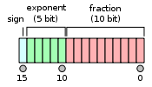

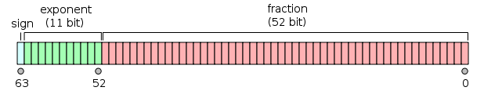
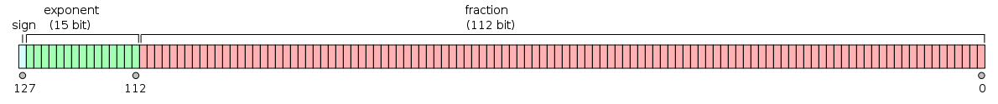
Other IEEE 754 Formats
Half precision (binary16)
Single precision (binary32)
Double precision (binary64)
Quadruple precision (binary128)

Slide 12
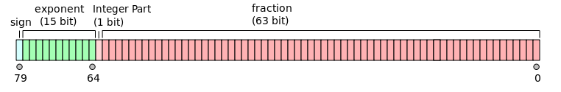
Other Formats: bias calculated from number of bits in the exponent
X86 Extended precision (80 bits)
How to calculate the bias?
Bias
Used in 8087 Math co-processor and subsequently in all x86 hardware floating point (intermediate operations).
Note explicit J-bit
2⁽⁵⁻¹⁾ – 1 = 2⁴ -1 = 15

Slide 13
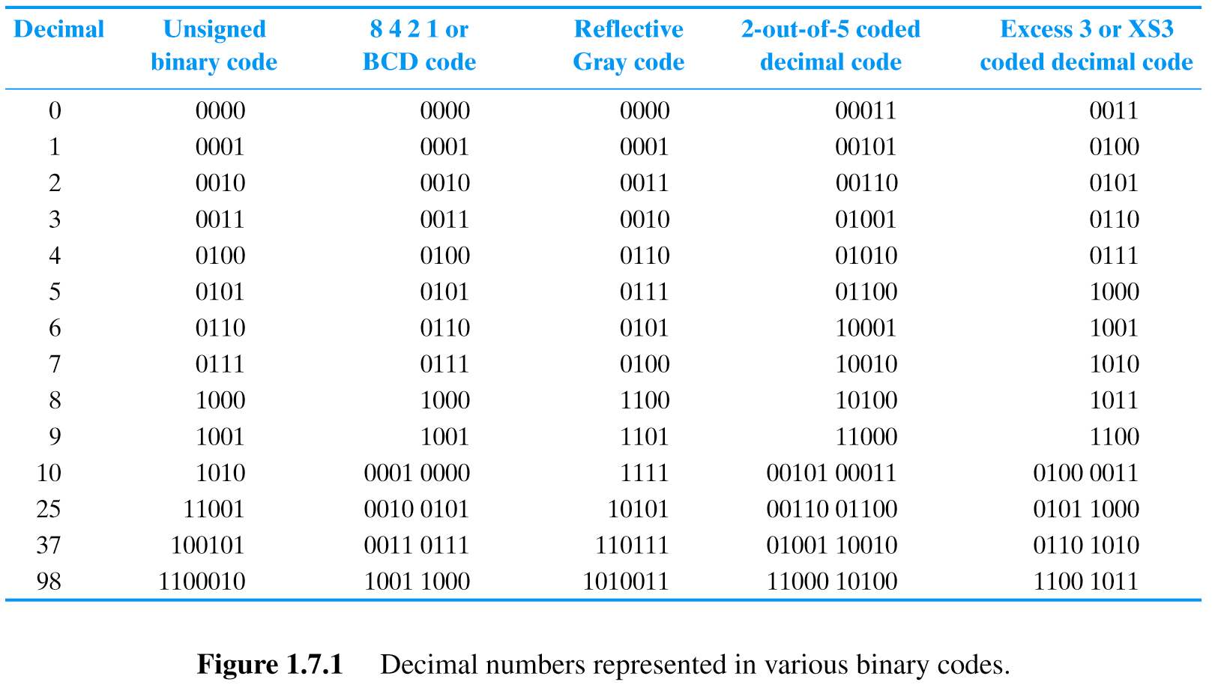
BCD (Binary Coded Decimal)
Used in early 4-bit μP
Simple displays
4 Bits/Decimal Digit
2
5

Slide 14
ASCII

Slide 15
ASCII
American Standard Code for Information Interchange (pronounced: As’ key)
For encoding text
Universally used
  EBCDIC (old IBM mainframe standard) died
  Unicode for international (non-Roman) languages
    UTF-8 8-bit variable width encoding (1-4 bytes)
    UTF-16 16-bit variable width encoding
    UTF-32 32-bit fixed width encoding
UTF-8 commonly used for HTML/web browsers, FreeBSD, Linux
Gcc uses UTF-32

Slide 16
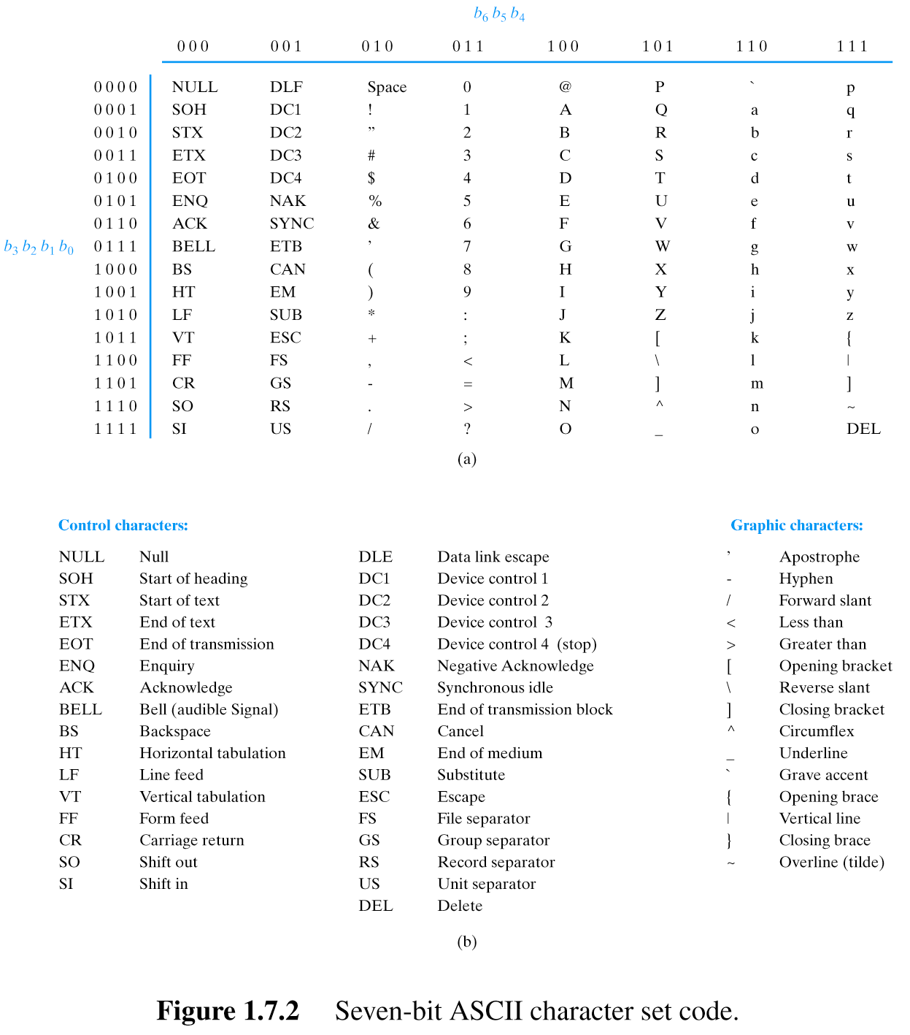
“ECE171”
As a string of characters
E C E 1 7 1
1000101100001110001010110001011011101100010000000

Slide 18
Gray Code

Slide 19
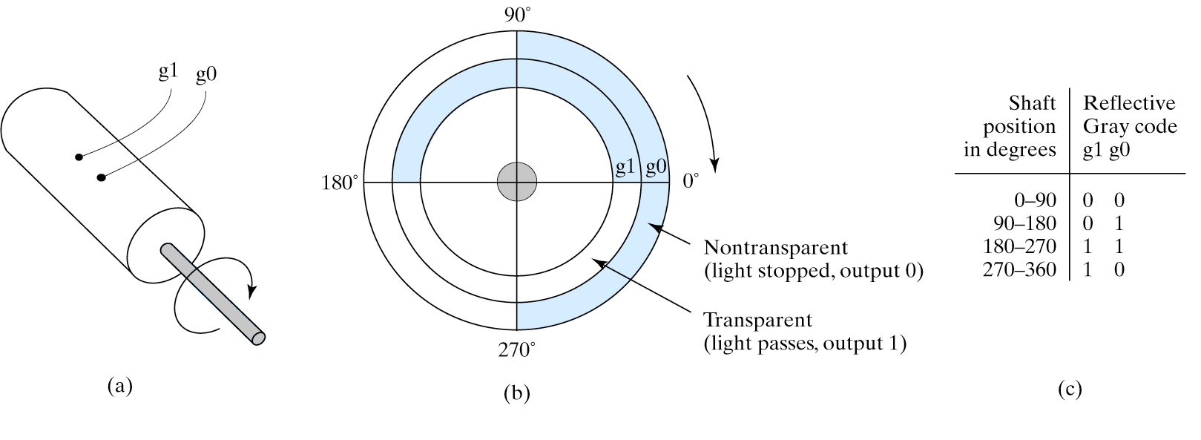
Reflective Gray Code (RGC)
Adjacent codes differ by single bit
  “Unit Distance Code”
Often used in interfacing mechanical sensors
Shaft position

Slide 20
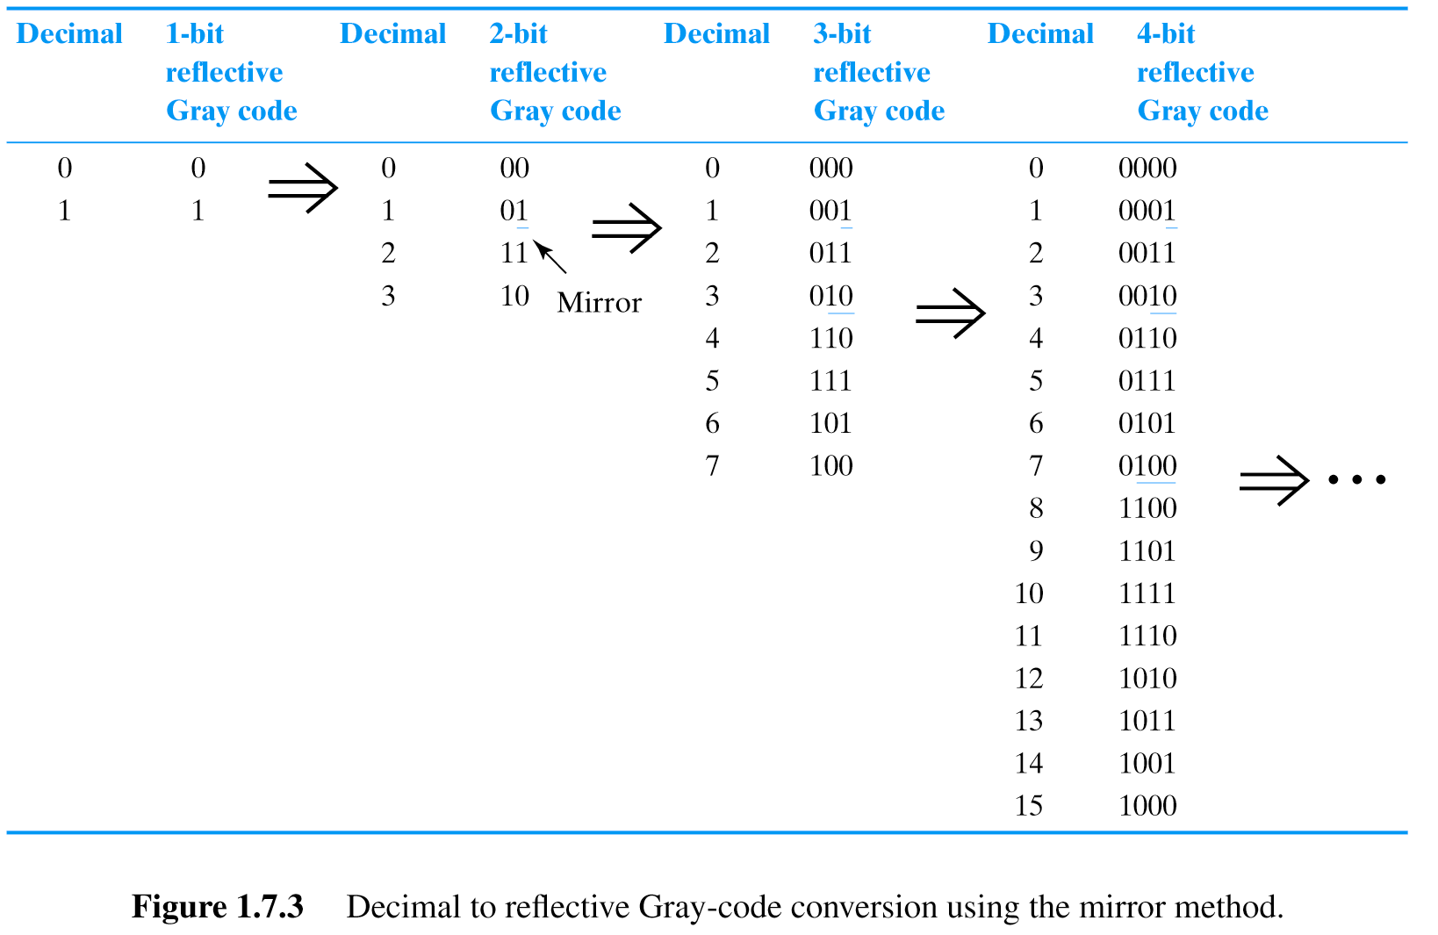
Reflective Gray Code

Slide 21
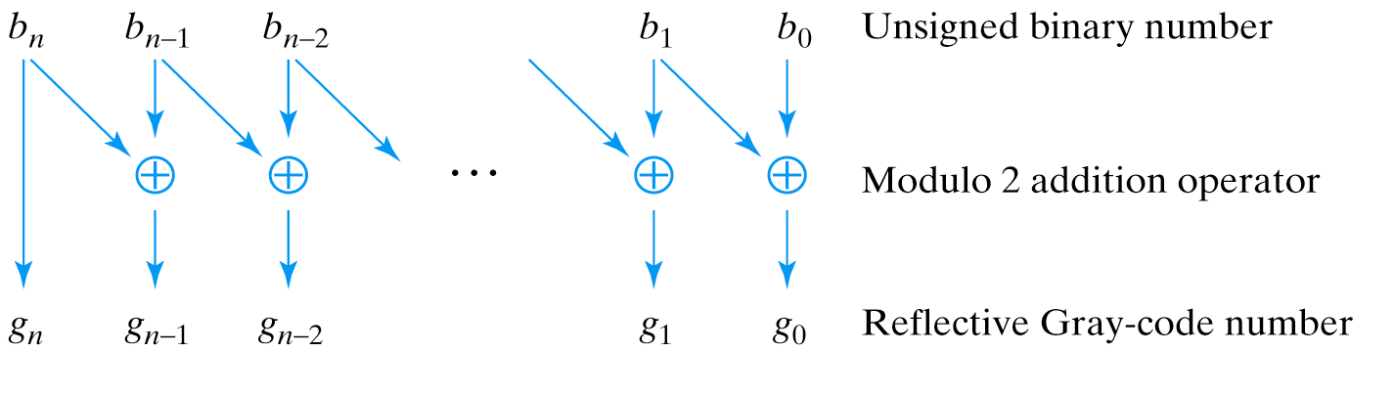
Reflective Gray Code (Conversion)
Notes:
Explain modulo 2 (XOR) addition

Slide 22
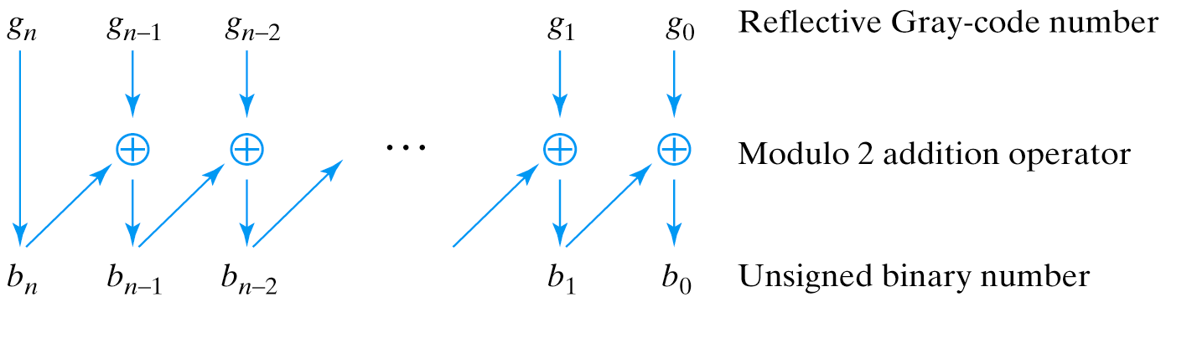
Reflective Gray Code (Conversion)
Notes:
Explain modulo 2 (XOR) addition

Slide 23
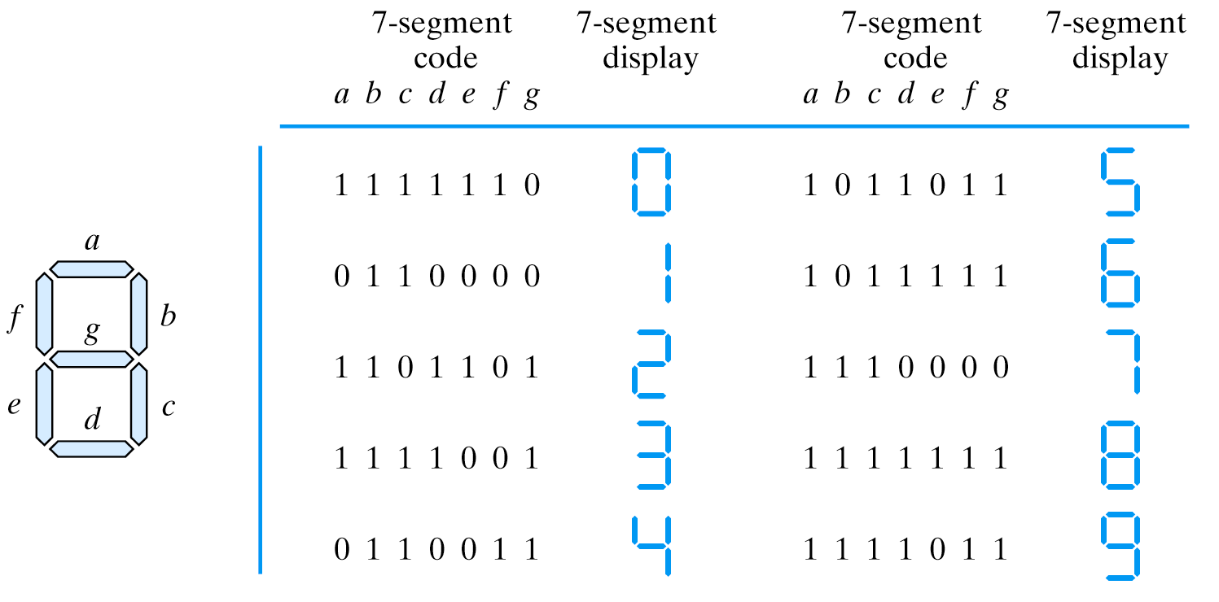
7-Segment Code

Slide 24
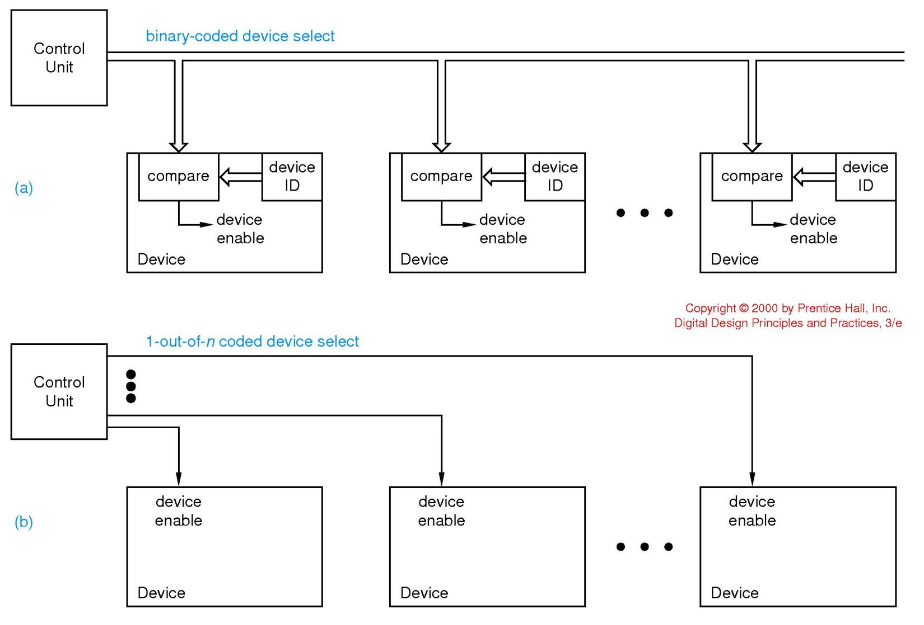
1-out-of-n codes (1-hot)
With binary coded device selection
8 devices
2³ = 8
therefore 3 bits (wires) suffice…
if devoted 8 wires…
used in SCSI disk drives, PCI enumeration
000
001
111
With 1-hot code coded device selection

Slide 25
Serial Data Transmission & Storage

Slide 26
Serial Data Transmission & Storage
Low Voltage Differential Signaling
Parallel
  Storage: each bit of word read/written simultaneously
  Transmission: each bit has separate signal path
Serial
  Reduce costs
  Simplify design
  Higher speed (LVDS, skew)
Applications
  USB
  PCI Express

Slide 27
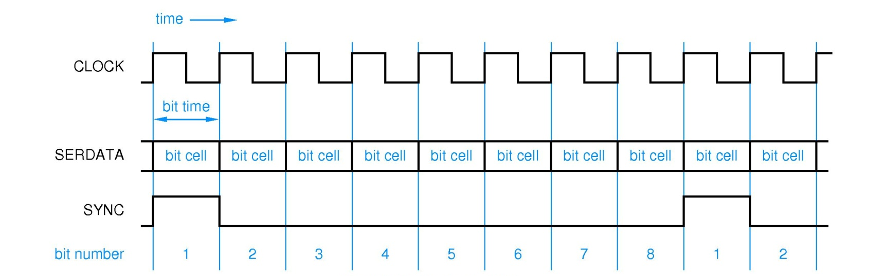
Serial Data Transmission & Storage
Clock
  Determines rate at which bits are transmitted (“bit rate”)
  “bit time”= clock period (1/bit rate) = “bit cell”
Sync
  Determines start of byte (or packet)
Data Format
  Determined by “line code”

Slide 28
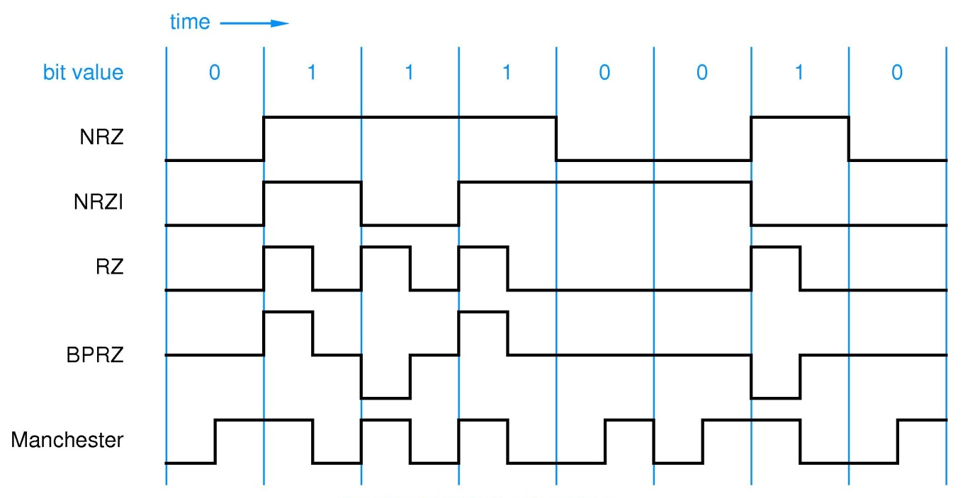
Codes for Serial Data Transmission and Storage
NRZ – Non Return to Zero
NRZI – Non Return to Zero Invert (on ones)
  Transition based
  Differential signaling: USB
RZ – Return to Zero
BPRZ – Bipolar Return to Zero
  “DC balanced”
  MLT-3 (100 Base T Ethernet)
Manchester encoding
  Guarantees a transition in every bit cell
  Facilitates clock recovery
  Requires higher bandwidth
  Original coax-based 10 Mbps Ethernet
Other techniques for DC balancing (and edge density)
  m-out-of-n-codes (e.g. 8B10B): Gigbabit Ethernet
Explain NRZI → transition based code (disk drives store don’t store 0s/1s but adjacent places may have different/same flux as neighbor, LVDS applications)
May need/want to explain source synchronous vs. embedded clocks and clock recovery
Notes:
Explain NRZI → transition based code (disk drives store don’t store 0s/1s but adjacent places may have different/same flux as neighbor, LVDS applications)
May need/want to explain source synchronous vs. embedded clocks and clock recovery

Slide 29
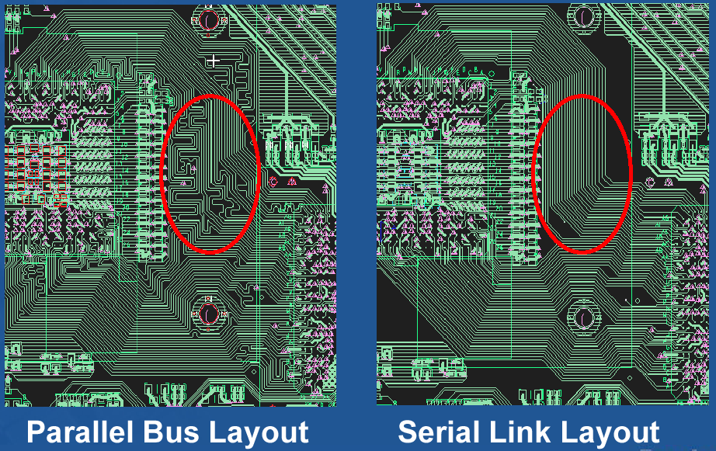
Why Serial?
“Parallel”
“Serial”
Device A
Device B
Device A
+
Device B
-
+
-
10 bidirectional wires at 250Mbps
pair unidirectional wires at 2500Mbps (2.5Gbps)

Slide 30
Traditional Parallel Bus
Device A
Device B
Used in low to medium 100 MHz range
Issues
  Board trace length effect on skew
  Clock skew across devices
  Faster data rate squeezes “eye”
Because clock is distributed to both sender and receiver, its arrival time at sender and receiver is not simulataneous, and there will be skew with respect to the sent or received data.
Does everyone know what’s meant by “eye” – it’s the window during which data is expected to be valid. “Guardband” is test term which refers to the necessary “safety”, closing the eye. This is an issue in system performance, error rates, and of course in testing.

Slide 31
Source Synchronous Bus
Device A
Device B
Used in 200MHz to 1.6GHz range
Clock signal is “forwarded” with data
Design impact:
  Board layout track length mismatch
  still adds to skew
  Eliminates skew error term caused by clock domain skew
  Allows faster cycle times than parallel

Slide 32
Embedded Clock
Data
Clock
Clock signal embedded with data
Clock signal is “embedded” with data
  Received used digital phase locked loop (DPLL) to “recover” clock and determine where bit times are
  Edge density must guaranteed by encoding scheme
Examples
  PCI Express, USB, Serial RapidIO, Infiniband
  Intel’s new QuickPath Interconnect
We’ll look at the encoding scheme which ensures this in a moment

Slide 33
Edge Lock Technique (Tracking Receiver)
Device
A
Device
B
Device A sends pulse train to Device B
Device B “locks” onto edges
to be in sync with pulse stream
In order to achieve locking and clock recovery we need to ensure a certain density of edge transitions – this is where the encoding scheme comes in…

Slide 34
Ensuring Edge Density: m-of-n codes
Some 8-bit code words have too few 1s (or 0s) to ensure edge density sufficient to recover clock
8b10 encoding (developed by IBM in 1983)
  Use 10-bit code words, but only use a subset of the available 2¹⁰ code words
    No more than five 0s or 1s in a row
    Balanced number of 0s and 1s (difference between count of 0s and 1s in a string of at least 20 bits is no more than two.
  Benefits
    Ensure edge density
    Avoid DC bias at receiver from imbalance
      Running disparity for unbalanced codewords
  256 data characters
    All 8-bit bytes
    12 control characters (INIT, etc)
8 bit byte
10 bit code
Table lookup
Device A
Device B
Parallel
Data
TX FIFO
8B/10B
Encoder
Serializer
+
_
Deserializer
8B/10B
Decoder
RX FIFO
Parallel
Data
Parallel
Data
RX FIFO
8B/10B
Decoder
Deserializer
+
_
Serializer
8B/10B
Encoder
TX FIFO
Parallel
Data

Slide 35
Error Detection and Correction
Errors occur during data storage/retrieval and transmission
  Noise, cross-talk, EMI, cosmic rays, impurities in IC materials
  More common with high speeds, lower voltages
Use m-out-of-n codes to detect errors
  Not all possible codes are used (valid)
  Errors in used (valid) codes (hopefully) produce unused (invalid) codes
Notes:
Parity, ECC, CRC

Slide 36
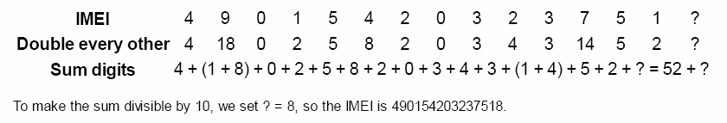
Example of Error Detection and Correction
Example: Luhn Algorithm
  Credit cards, IMEI (International Mobile Equipment Identity)
    Start from right, double every second digit
    Add all digits
    Add a final check digit to ensure sum is multiple of 10
Notes:
Parity, ECC, CRC

Slide 37
Differential Signaling
Differential, point to point
  Complementary signals transmitted
  Receiver detects voltage difference between lines
  Low amplitudes (200mV - 400mV typical), high speeds
  Good noise immunity
    Pair routed together – noise cancels out
LVDS – Low Voltage Differential Signaling
  ANSI/TIA/EIA 644-1995 standard (signaling only, not protocol or connectors)
  3.125 Gbps, +/- 350mV
  “Gbps at mWs” -- High speed & low power consumption
  FibreChannel, Gigabit Ethernet, HDMI, DVI, USB
Well suited to NRZI encoding – only care about transitions – signals “cross”
ANSI – American National Standards Institute
TIA Telecommunications Industry Association
EIA Electronics Industries Alliance
Edge rather than level sensitive!!!!
LVDS is a common technique and used in DVI and HDMI (Digital Video I/F) and (High Definition Multimedia I/F)

Slide 38
Differential Signaling

Slide 39
Sources
Prof. Mark G. Faust
John Wakerly

